Slide 1
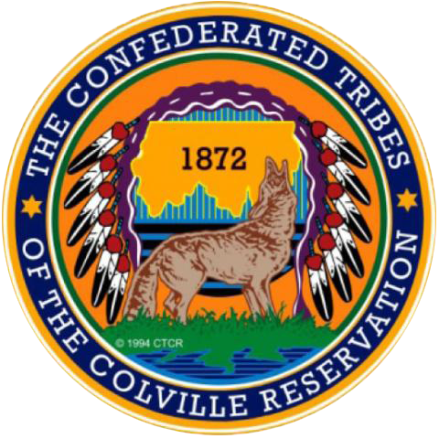
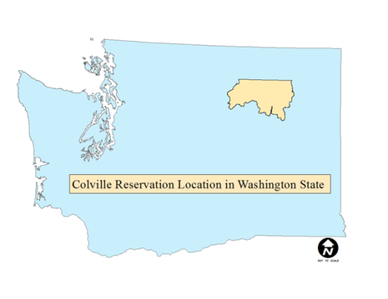
Let’s Talk About becoming Smoke ready
Fire and Smoke Workgroup
WRAP
July 26, 2021
Kris Ray, Air Quality Program Manager
Confederated Tribes of the Colville Reservation

Slide 2
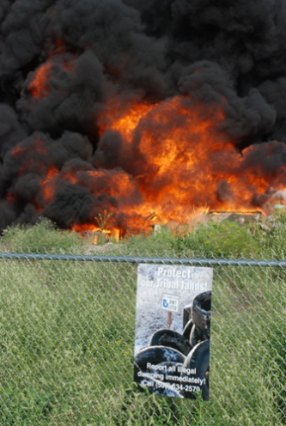
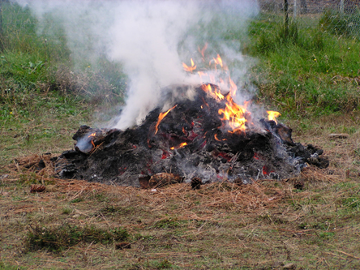
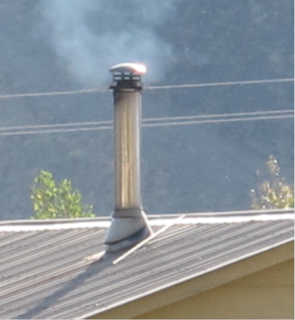
What does smoke - ready mean
Community based
All sources of smoke
Yearly smoke exposure
Prevention of health problems
Education and outreach
Mitigation actions
Coordination with partners

Slide 3
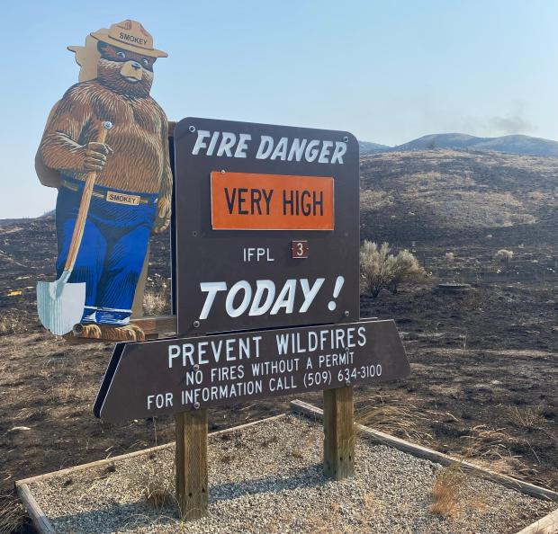
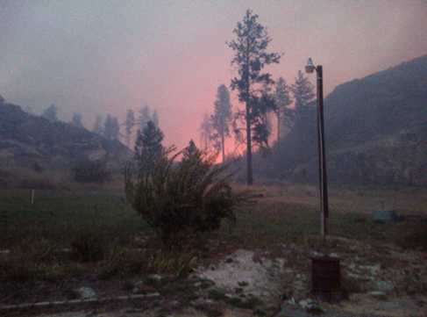
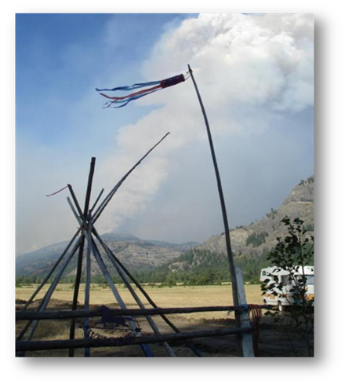
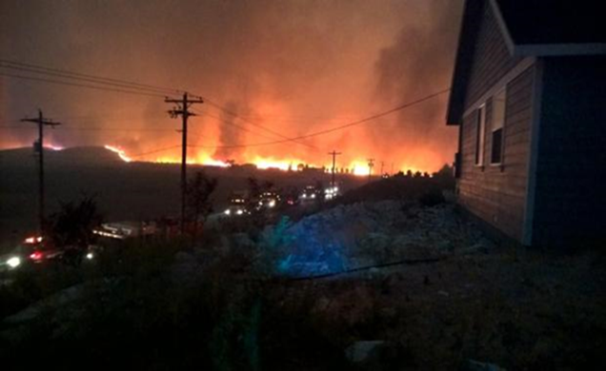
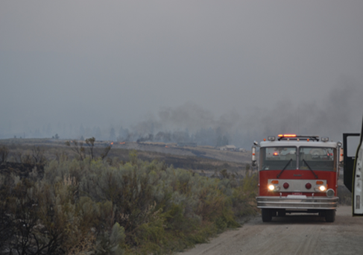
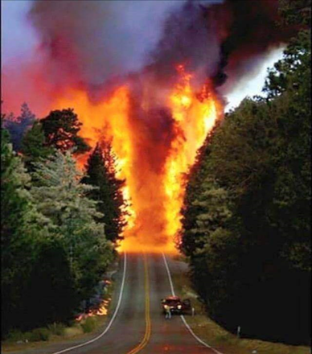
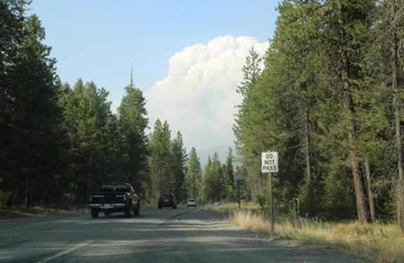
Wildfire Smoke The most Important Air Quality Issue We Face

Slide 4
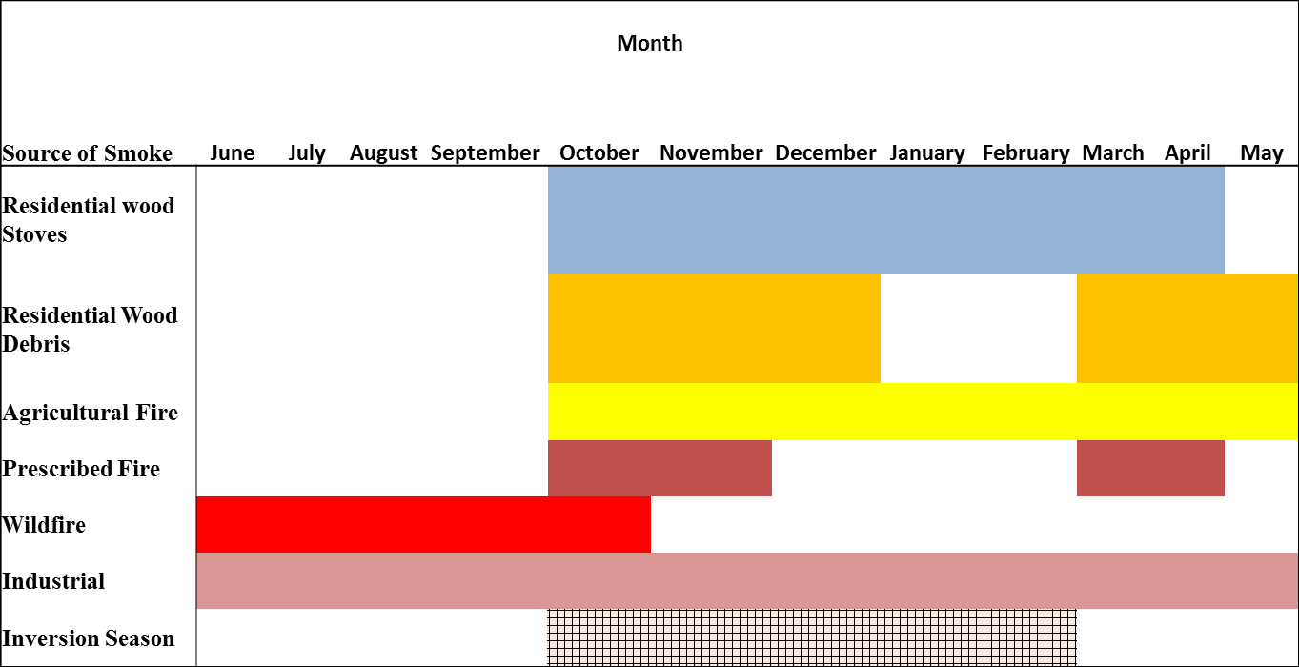
Timing of Emissions

Slide 5
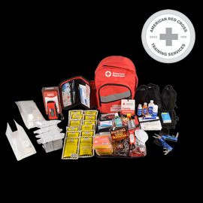
Pre-Smoke Event Planning
Communications
Very important during stressful situations
First task to get dropped during stressful situations
Maintain Monitoring Network
AQ Templates
Emergency Go Kit
ARA Factsheet
Tribal Contacts
Vicinity Map
Monitoring Network
AQI vs WAQA
Meteorological Sites Links
Add N95 Masks and Box Fan Filter

Slide 6
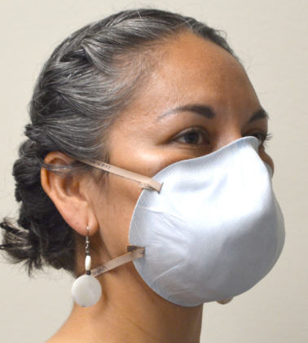
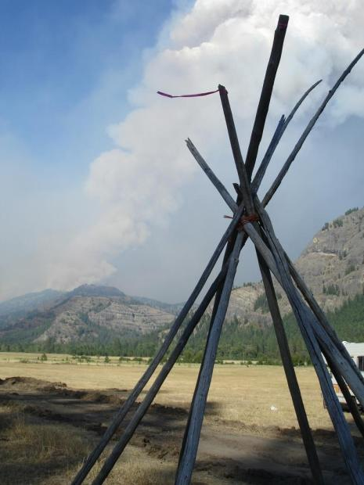
Actions during smoke events
Managing Buildings for Cleaner Air
Limit Door Use
Evaluate AC systems
Air Cleaners
Clean Rooms
Awareness of Smoke in Building
N 95 Masks
Visual Guide to AQI
Document and Record
Air Quality Index | Visibility (miles) | Activity Message | Using Visibility Index from 5 to under 1 mile
Good | 15+ | Air quality generally good | You Are: |  | Or You Have:
Moderate | 5 to 15 | Generally healthy, but maybe deteriorating, should avoid prolonged exposure | Adult, teenager or older child | Age 65 and over, pregnant or young child | Asthma, respiratory, lung or heart disease
Unhealthy for Sensitive Groups | 3 to 5 | Moderate outdoor activity for sensitive groups |  | Minimize outdoor activity
Unhealthy | 1 to 3 | Minimize outdoor activity |  | Stay inside
Very Unhealthy | Under 1 | Everyone should avoid all outdoor activities and stay inside |  | Stay inside or consider leaving the area
Hazardous

Slide 7
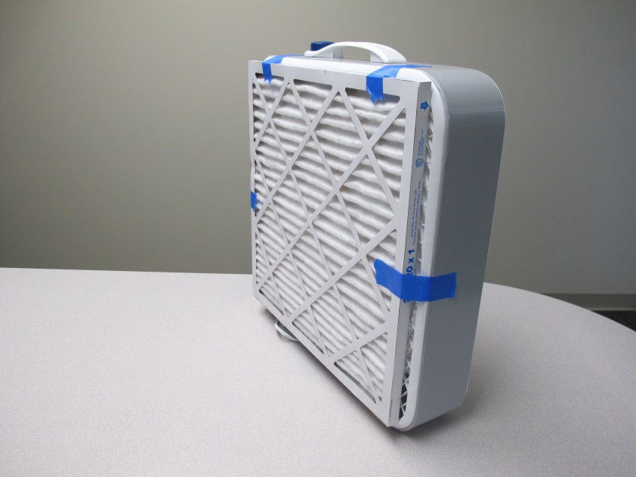
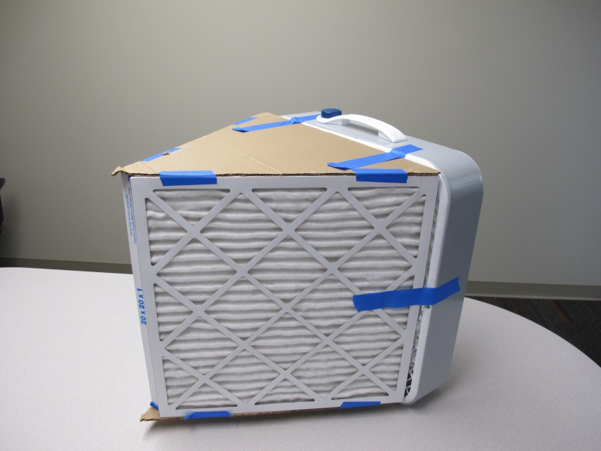
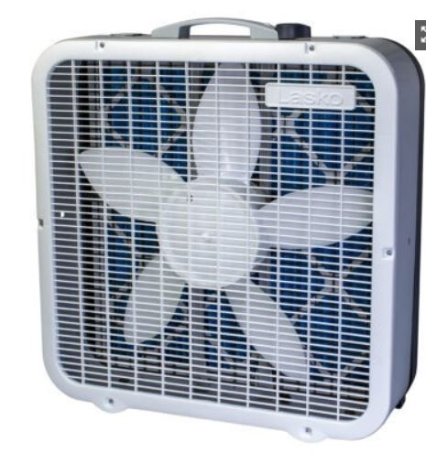
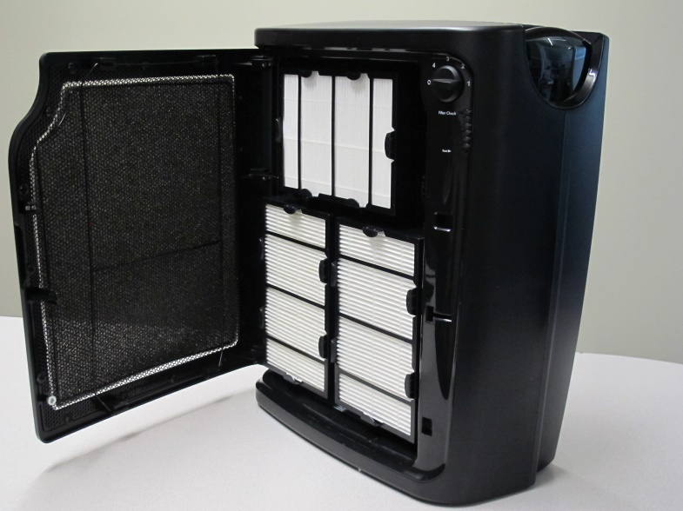
Portable Air Cleaners
Better
Good
Best

Slide 8
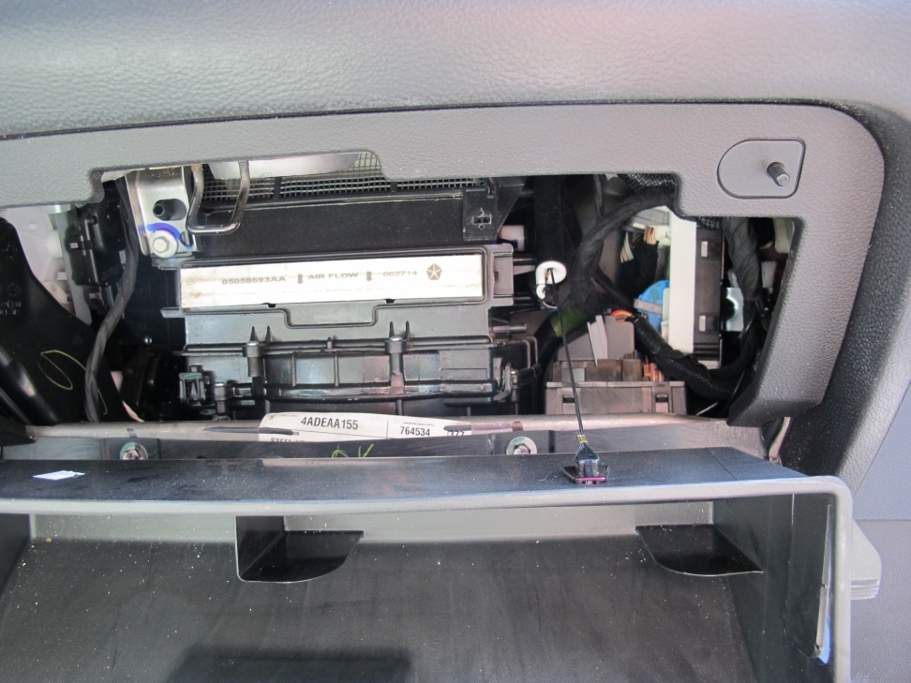
Vehicle Filters
Always use recirculate option
75% reduction while parked in 15 minutes
Less reduction when driving
Replace filters between 25,000 and 35,000 miles

Slide 9
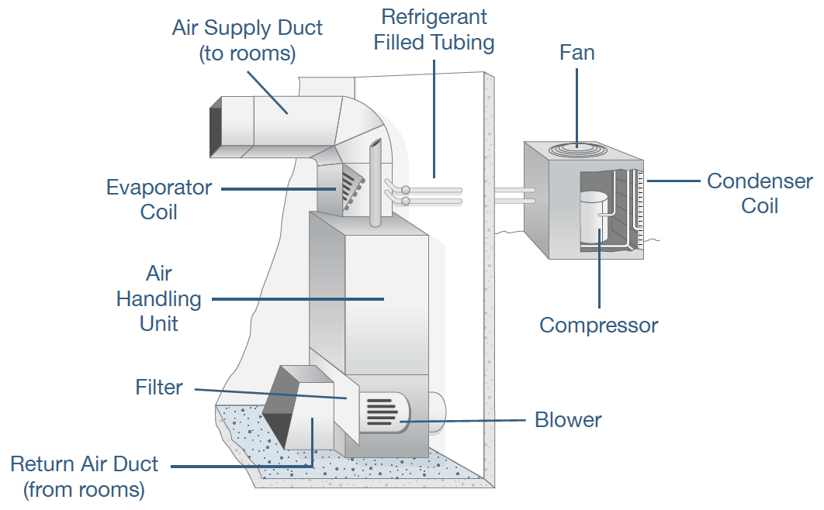
After the Smoke
Clean Buildings and Homes
Residuals and Odors
Wash Inside Walls
Shampoo Carpets
Laundry Clothes
Wash off Outside of House
Scented Candles and Air Fresheners Mask Smells
Service AC Units and Filters
Change Filter
Activated Charcoal Filters
Check and Clean Ductworks

Slide 10
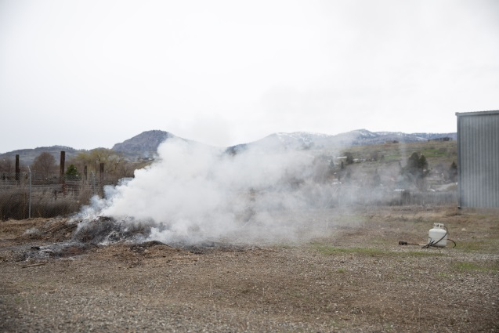
Wood stove Smoke
Actions
Stove Buy Back
Wood Stove Changeout
Dry Wood Promotions
Look at Your Smoke Outreach
Residential Vegetation Debris Burning
Alternatives to Burning
Composting
Chipping
Mulching
Landfill

Slide 11
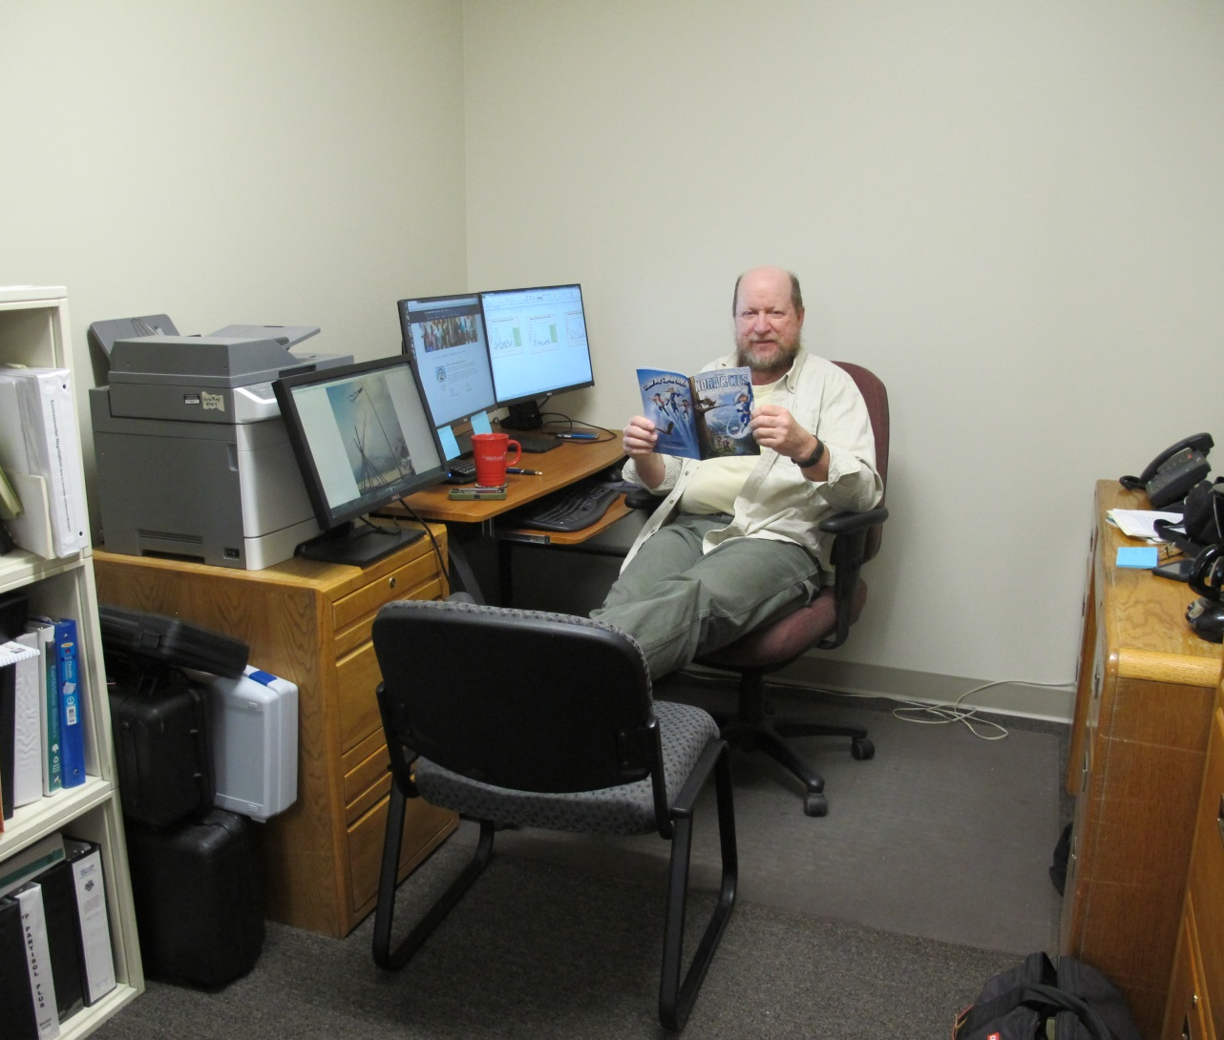
Control the Air You Breathe Become Smoke ready
Kris Ray, Air Quality Program Manager
Confederated Tribes of the Colville Reservation
509-634-2418; kris.ray@colvilletribes.com

Slide 12
References
Wildfire Smoke A Guide for Public Health Officials: https://www3.epa.gov/airnow/wildfire_may2016.pdf
Smoke Management Photographic guide: A visual Aid for Communicating Impacts : https://www.fs.fed.us/pnw/pubs/pnw_gtr925.pdf
Air Quality Program, Confederated Tribes of the Colville Reservation: https://www.cct-enr.com/environmental-trust/
Air Pollution and School Activities: https://www.doh.wa.gov/Portals/1/Documents/Pubs/334-332.pdf
Guide to Air Cleaners in the Home: https://www.epa.gov/indoor-air-quality-iaq/guide-air-cleaners-home
Smoke Ready Tribal Communities, 2017 National Tribal Forum on Air Quality: https://www.dropbox.com/sh/wdb9pz373cxb15i/AADsESkgv_fOkim8TQrxbeQBa/050117_SmokeReady?dl=0
Smoke Ready Toolbox for Wildfires: https://www.epa.gov/air-research/smoke-ready-toolbox-wildfires
Box Fan Filter Video and Instructions - https://www.cct-enr.com/box-fan-filter

